Slide 1
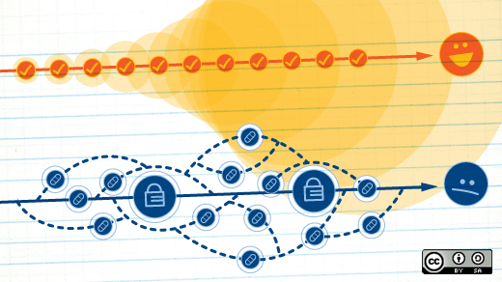
Configuration Management Tool
Group-10 BIS

Slide 2
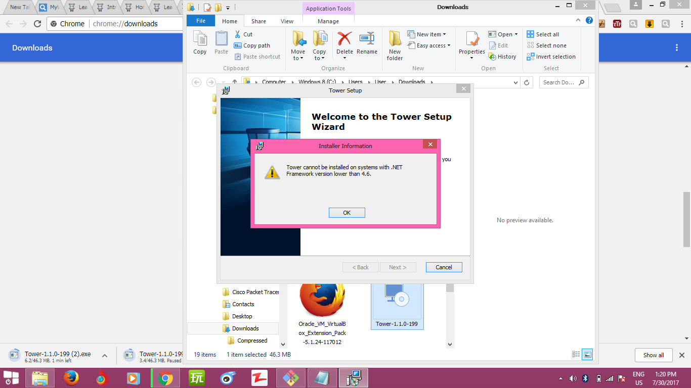

Slide 3
Members
Hsu Yie Oo (4BIS-29)
May Thin Khaing (4BIS-30)
Khaing Yie Mon (4BIS-37)
Su Mon Phyo (4BIS-40)

Slide 4
What is CM tool?
what make implementing and enforcing these changes possible
each tool is unique, but they all provide some level of support for important features
Properties:
-Enforcement
- Version control friendly
-Enables change control processes
- Abstraction(same config file can be used in diff OS)

Slide 5
Tower
What is Tower?
- the best Git client for Mac and Windows
- help over 80,000 users in companies like Apple,
Google, Amazon, Twitter, and Ebay
-can use with GUI or CLI

Slide 6
What is VCS?
is independent of the kind of project / technology / framework you're working with
also, don't confuse a VCS with a backup or a deployment system
records the changes you make to your project's files

Slide 7
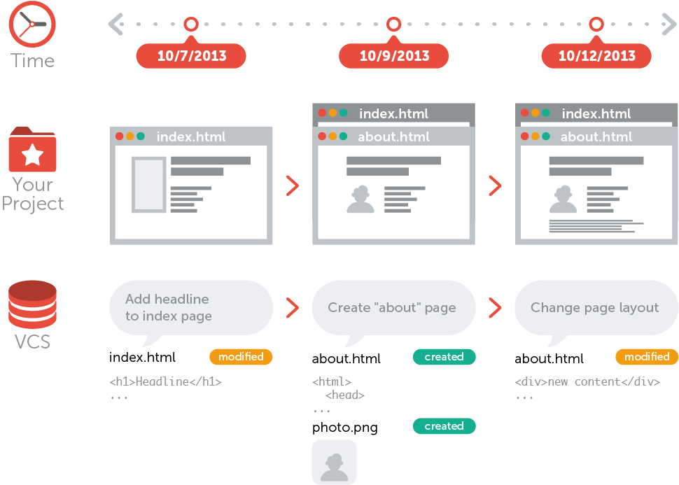
What is VCS?

Slide 8
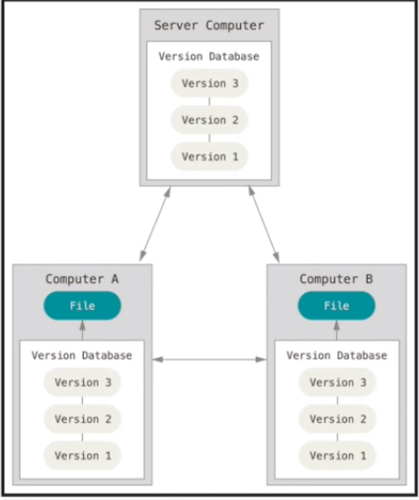
Benefits
Collaboration
Storing Versions (Properly)_without a VCS, this becomes tedious and confusing very quickly:
Restoring Previous Versions
Understanding What Happened
Backup

Slide 9
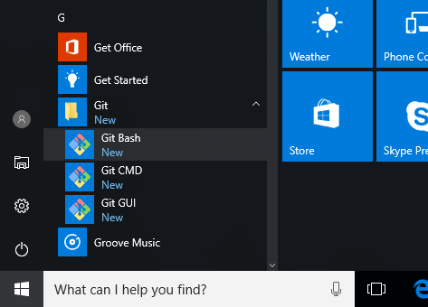
Setting Up Git
Installing Git on Windows( git-for-windows.github.io)
Download and install Tower.exe
Configuring Git
# git config --global user.name “Khaing Yie Mon“
#git config --global user.email
“khaingyiemon97@gmail.com"

Slide 10
Local & Remote Repositories
A "local" repository resides on your local computer as a ".git" folder inside your project's root folder
You are the only person that can work with this repository, by committing changes to it
A “Remote” repository typically located on a remote server on the internet or in your local network
No working directory but it exclusively consists of the ".git" repository folder.
Teams are using remote repositories to share & exchange data

Slide 11
!!! In Git, the repository is just a simple hidden folder named ".git" in the root directory of your project

Slide 12
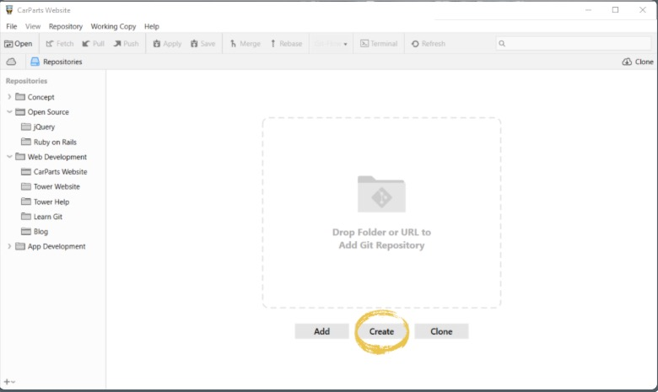
Creating New Repositoriess

Slide 13
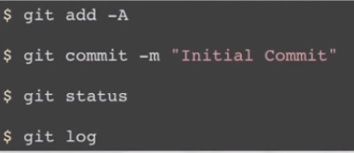
First Commit

Slide 14
For Commit
"status" command=> to get a list of all the changes you
performed since the last commit
#git status
"log" command=>lists all the commits that were saved
in chronological order
#git log

Slide 15
To display detail changes in commit
#git log -p
commit 2dfe283e6c81ca48d6edc1574b1f2d4d84ae7fa1
Author: Tobias Günther <support@learn-git.com>
Date: Fri Jul 26 10:52:04 2013 +0200
Implement the new login box
diff --git a/css/about.css b/css/about.css
index e69de29..4b5800f 100644
--- a/css/about.css
……..
<html>
………..
</head>

Slide 16
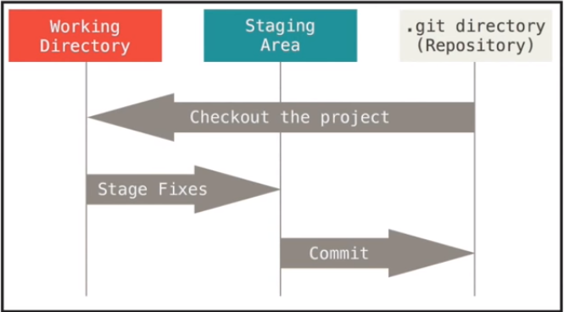
Add File to Staging Area
Staging Area=> -one of Git's greatest features
-it allows you to determine which of
your local changes shall be committed
# git add –A
#git status

Slide 17
The Status of a File
Untracked=> not under version control and VCS doesn't watch for (or "track") changes to this file
Tracked => already under version control and Git watches these files for changes and allows you to commit or discard them

Slide 18
3 Categories of commit
"Changes not staged for commit"
"Changes to be committed"
"Untracked files“

Slide 19
#git status
# On branch master
# Changes not staged for commit:(use "git add/rm <file>... " to update what will be committed)(use "git checkout -- <file>..." to discard changes in working directory)
modified: css/about.css
modified: css/general.css
deleted: error.html
modified: imprint.html
modified: index.html
# Untracked files:(use "git add <file>..." to include in what will be committed)
new-page.html
no changes added to commit (use "git add" and/or "git commit -a")

Slide 20
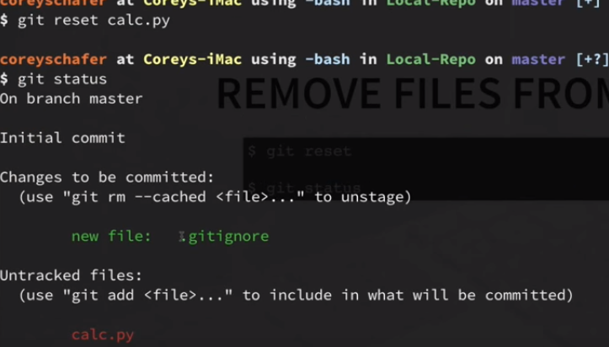
Removing File From Staging Area
#git reset
#git status

Slide 21
Metadata in Commit
Every commit item consists 4 metadata:
-Commit Hash(unique identifier: a 40-character checksum )
-Author Name & Email
-Date
-Commit Message

Slide 22
To Remove
to record the removal of "error.html" in the next commit:
#git rm error.html

Slide 23

Cloning a Remote Repository

Slide 24
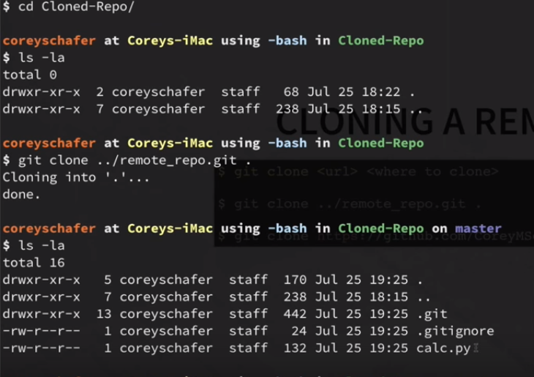
Cloning Cont’d

Slide 25

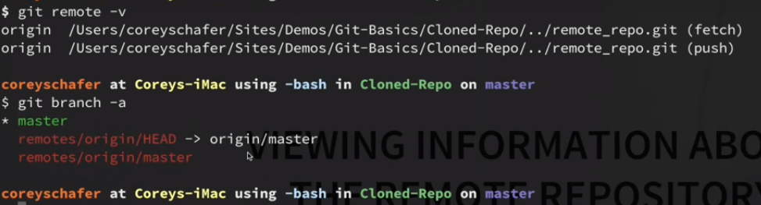
Viewing Info About Remote Repo:

Slide 26
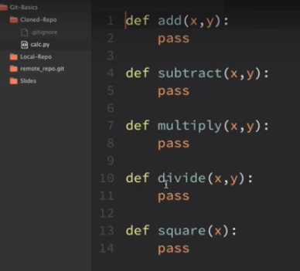
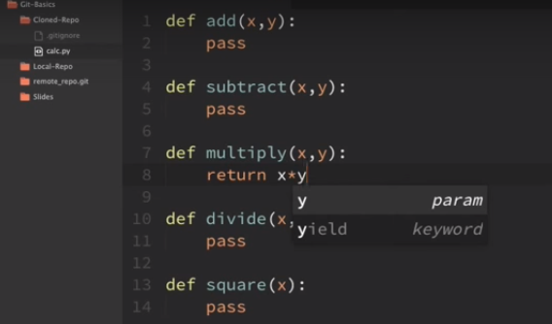
Pushing Changes
"git push" makes sure that everybody has always access to the latest developments. And, as a bonus, it can serve as your remote backup.

Slide 27

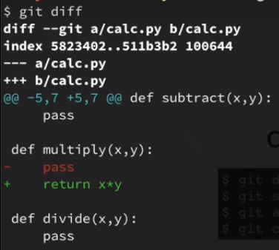
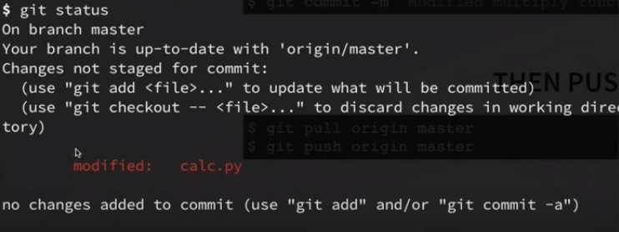
Pushing Changes

Slide 28

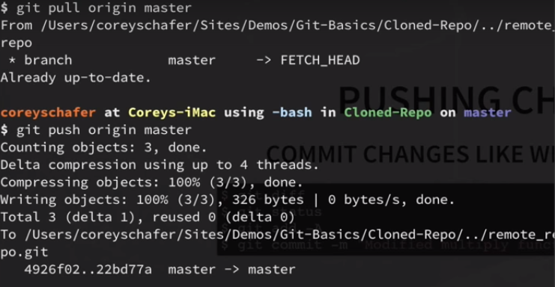
Pull and Push

Slide 29
Branching
one of Git’s most powerful features
the perfect tool to help you avoid mixing up different lines of development

Slide 30

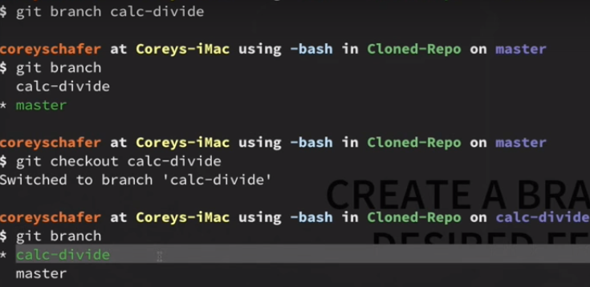
Create a Branch

Slide 31

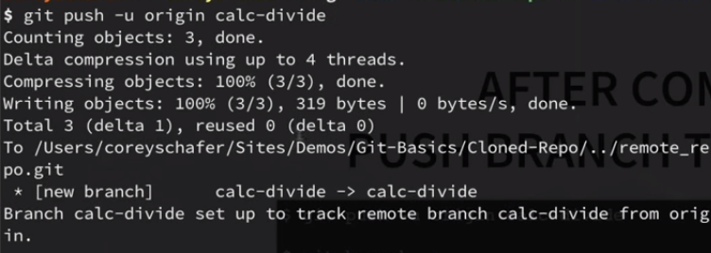
After Commit, Push Branch to Remote

Slide 32
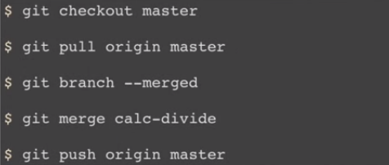
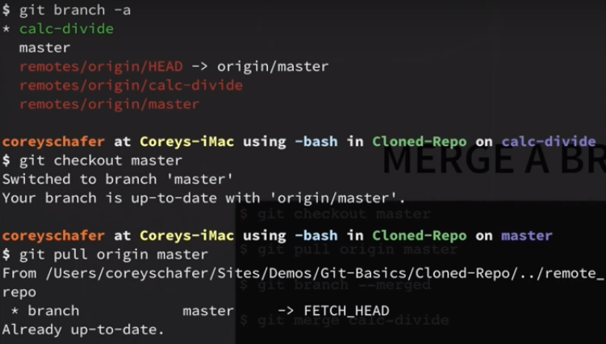
Merging Branch

Slide 33
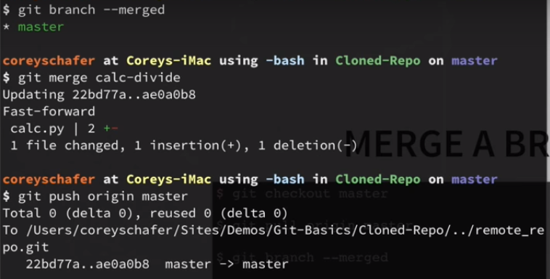
Merging Branch Cont’d

Slide 34
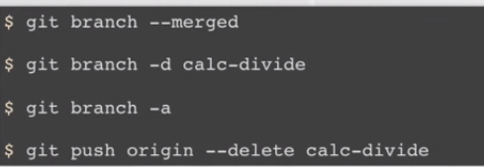
Deleting Branch

Slide 35
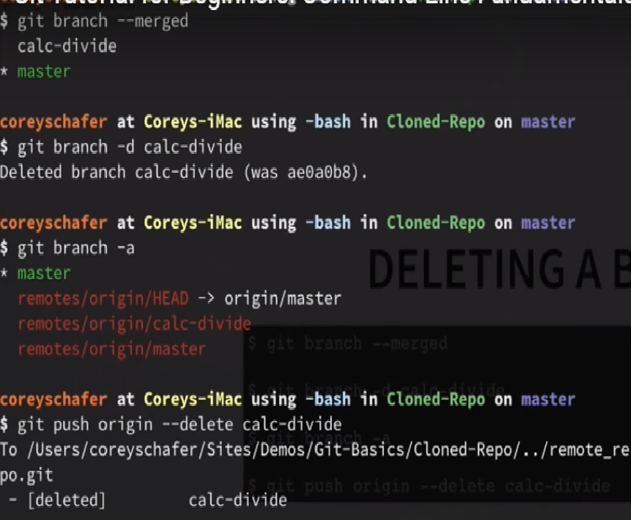
Deleting Branch Cont’d

Slide 36
Thank You, All….

